Slide 1
REAL-TIME AIR AND NOISE POLLUTION DETECTION SYSTEM USING IoT
ABSTRACT: Industrialization and urbanization has increased the pollution in an alarming rate. This increase in the pollution has turned out to be a great threat to the living beings. This problem is the main reason for the reduced life span of human beings. In order to monitor it, we are going to make an IOT based air and noise pollution monitoring system. We have used MQ7 sensor and sound detector in our project. The noise level is displayed in decibels and the air pollution level is displayed in ppm. We can install this system anywhere and we can monitor the pollution levels from anywhere using our mobile or laptop.

Slide 2
WORKING FUNCTIONALITY
The system is developed using IOT (Internet Of Things). The air pollution levels is recognized by MQ7 sensor. The MQ7 sensor sense co levels as it is the major pollutant. The noise levels are recognized by sound detector. When we connect these sensors to the Raspberry Pi, it will sense the levels. It displays air pollution level in ppm and noise level in db. The sensors give the output values in analog format. To convert those analog values to digital values, we use ADC (analog to digital converter). MQ7 sensor senses the gases from 20 to 2000 ppm. If the level exceeds 2000 ppm, it will start creating mild allergies and it is reported as bad air. If the noise level returned is 60 db, it indicates normal conversational noise. Ubidots is the IOT platform which facilitates us to view the results and also helps in analyzing them. Advanced IP Scanner is used to scan the ip addresses as our system main aim is to work using internet

Slide 3
DESIGN OF PROPOSED SYSTEM
The proposed air and noise pollution monitoring system
DIFFERENCE COMPONENT OF THE SYSTEM
GIVEN BELOW
RASPBERRY PI 3
POWER SUPPLY
USB PORT
SD CARD

Slide 4
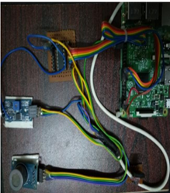
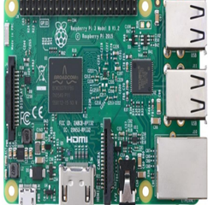
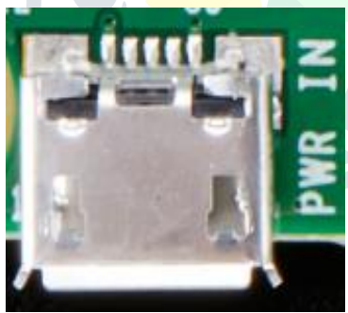
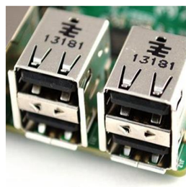
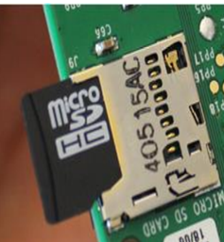

Slide 5
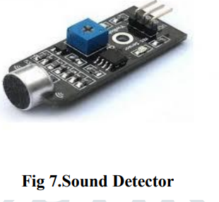
SOUND DETECTOR
Using sound sensor we can detect ambient sound. This board along with the microphone, has a small built-in amplifier (integrated circuit LM386). The connection scheme is very clean, composed of only 3 pins: Vcc, GND and S (signal). In the middle of the plate, there is a potentiometer for sensitivity adjustment. The board works with 5V voltage, and the signal pin should be connected preferably to an analog port, since the generated signal is variable, and thus we can see the different levels of noise picked up by the microphone

Slide 6
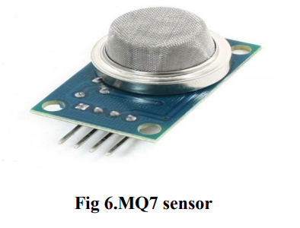
MQ7 SENSOR
This is a simple-to-use Carbon Monoxide (CO) sensor, suitable for sensing CO concentrations in the air. The MQ-7 can detect CO-gas concentrations anywhere from 20 to 2000ppm. This sensor has a high sensitivity and fast response time. The sensor’s output is an analog resistance. The circuit connection is very simple as it has only 3 pins. all you need to do is power the heater coil with 5V, add a load resistance, and connect the output to an ADC. It has good sensitivity to combustible gas in wide range, high sensitivity to natural gas, long life and low cost

Slide 7
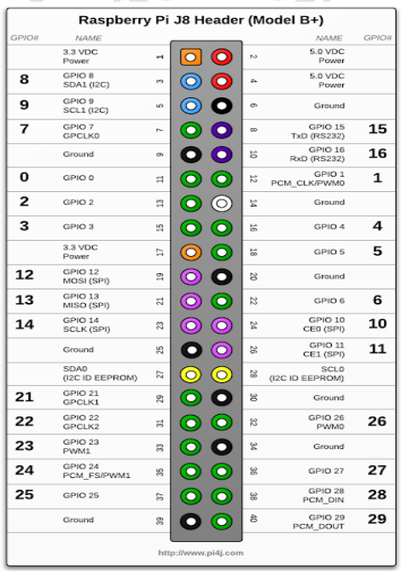
GPIO PIN DIAGRAM
One powerful feature of the Raspberry Pi is the row of GPIO (general purpose input/output) pins along the edge of the board, next to the yellow video out socket. These pins are a physical interface between the Pi and the outside world. At the simplest level, you can think of them as switches that you can turn on or off (input) or that the Pi can turn on or off (output). In our system, 11th pin is treated as clock, 9th pin is treated as MISO (master input slave output). 10th pin in treated as MOSI (master output slave input) and 8th pin is treated as chip select.

